Slide 1
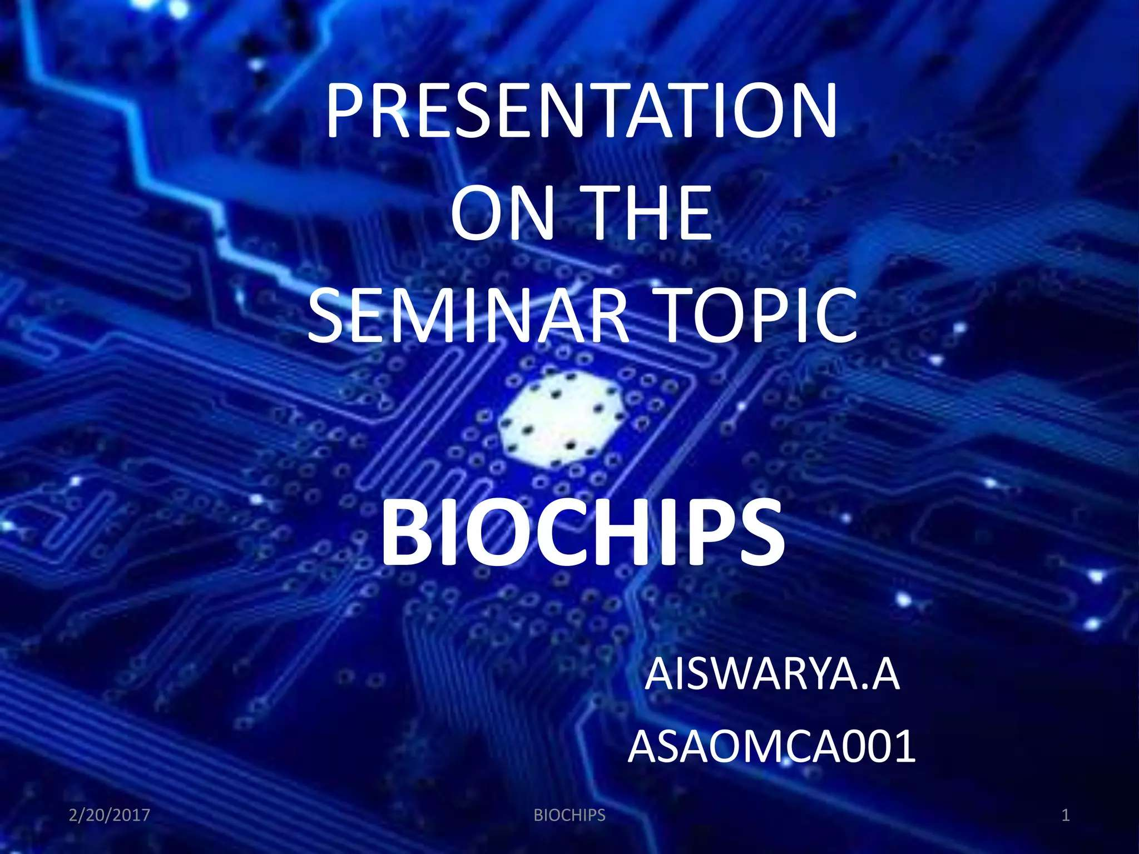


Slide 2

Presented by:
ARULDOSS S
DHAVANRAJ K
GNANAPRAKASH M
KARUPPAIYA V

Slide 3
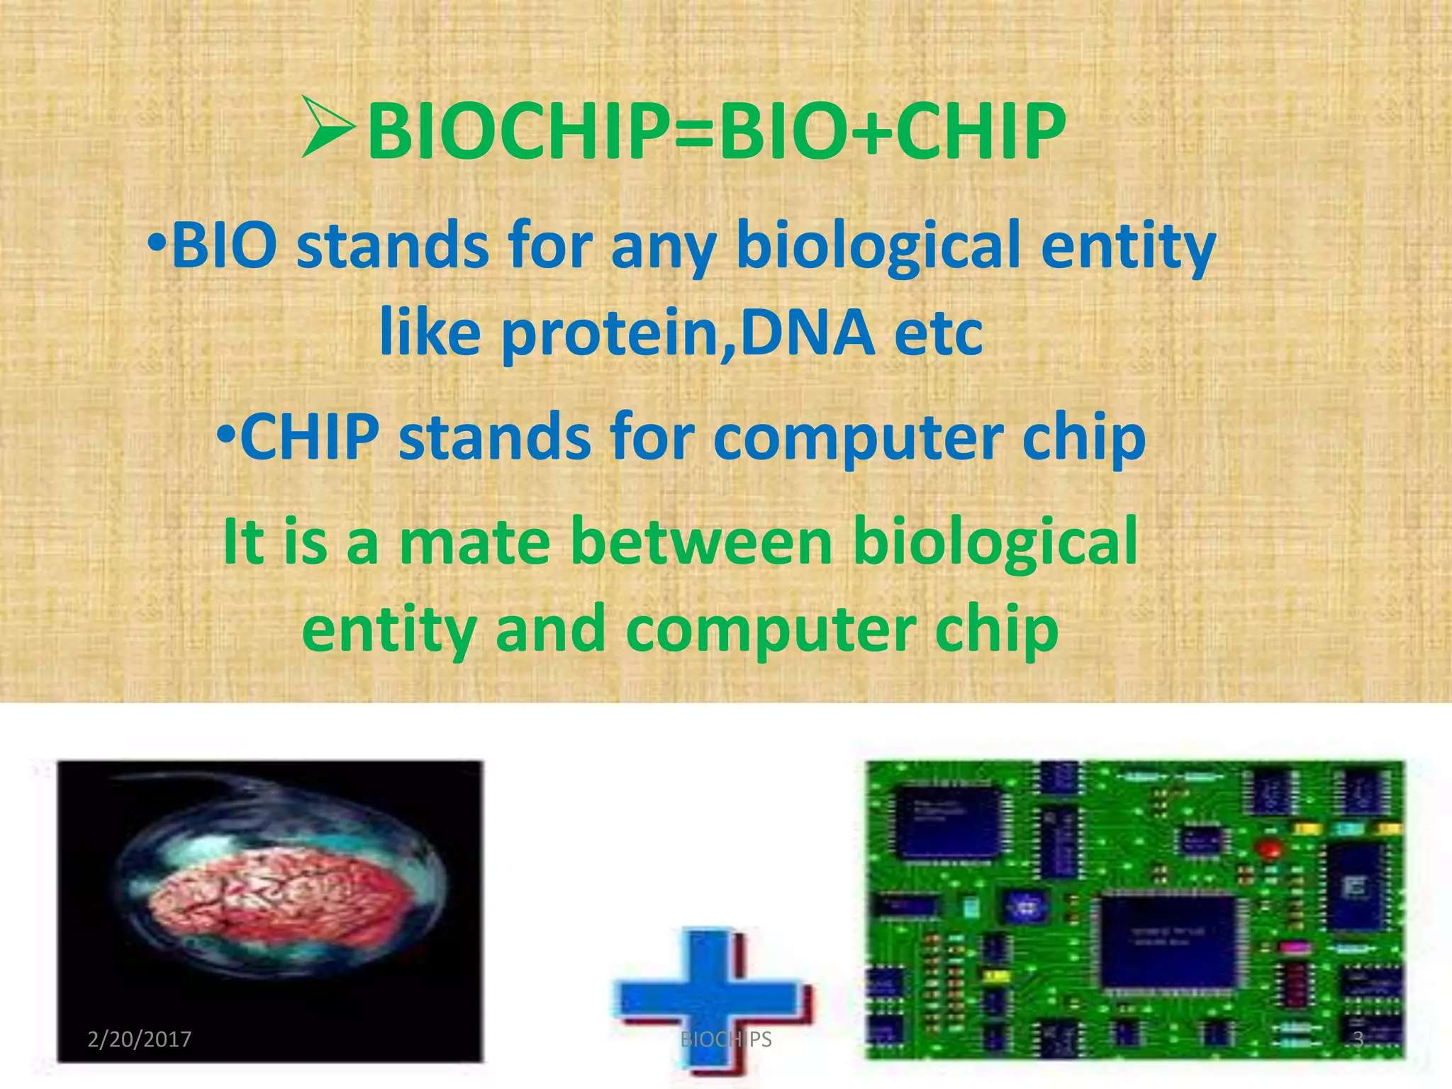

Slide 4
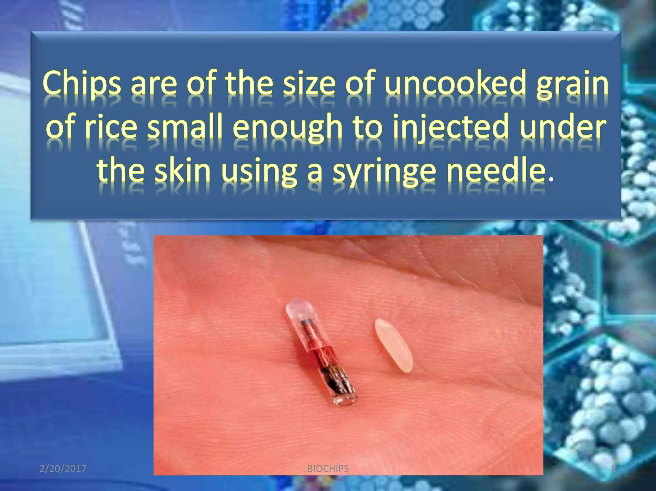

Slide 5
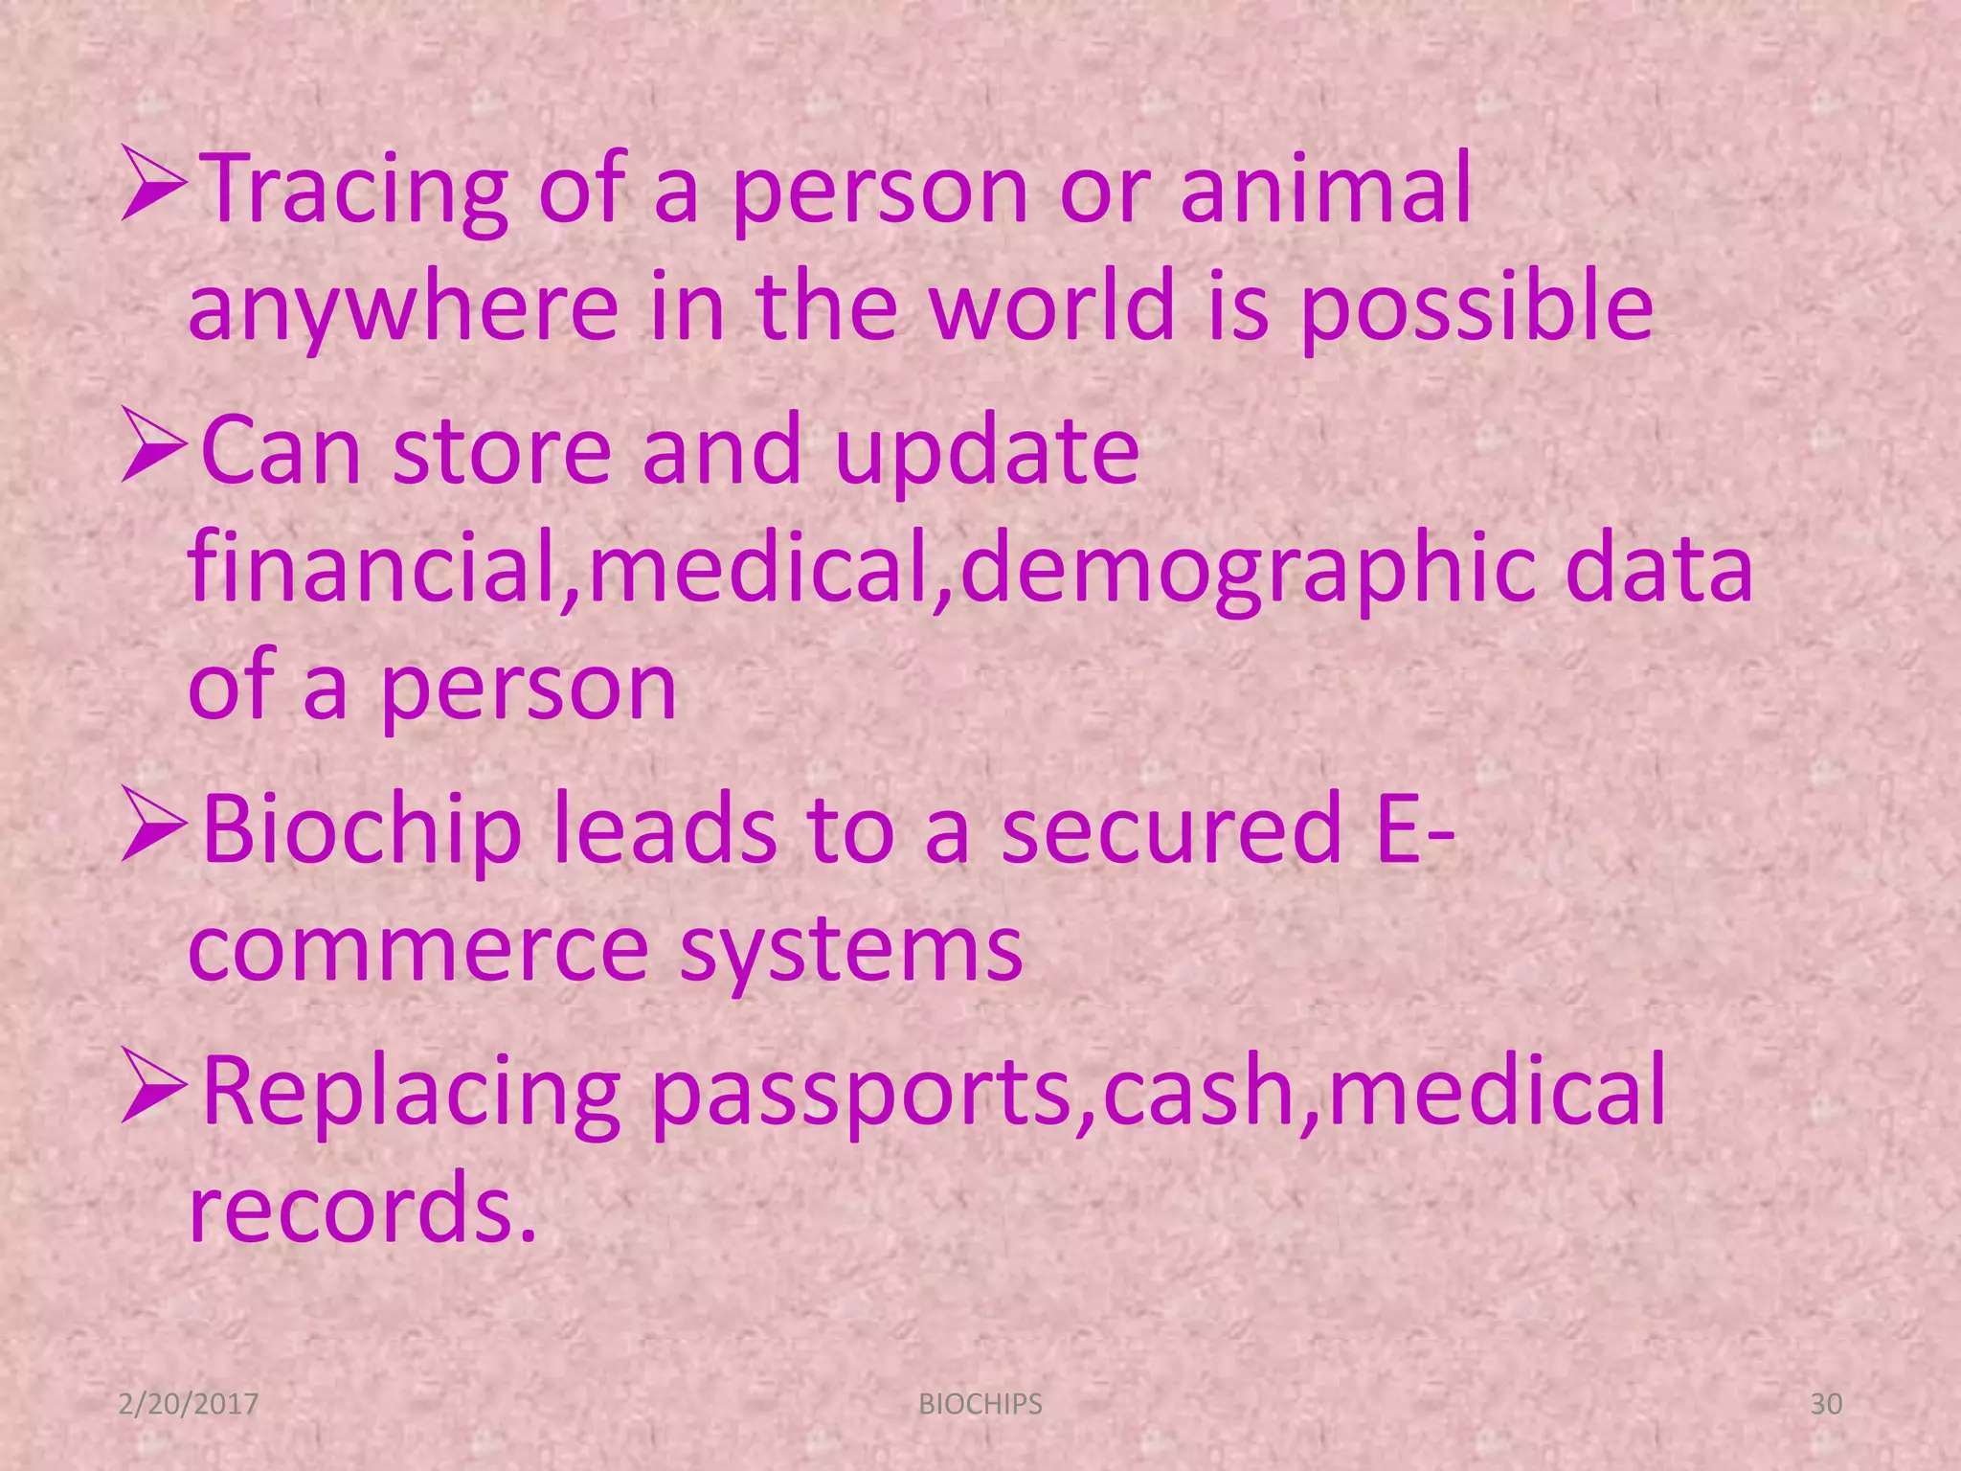

Slide 6
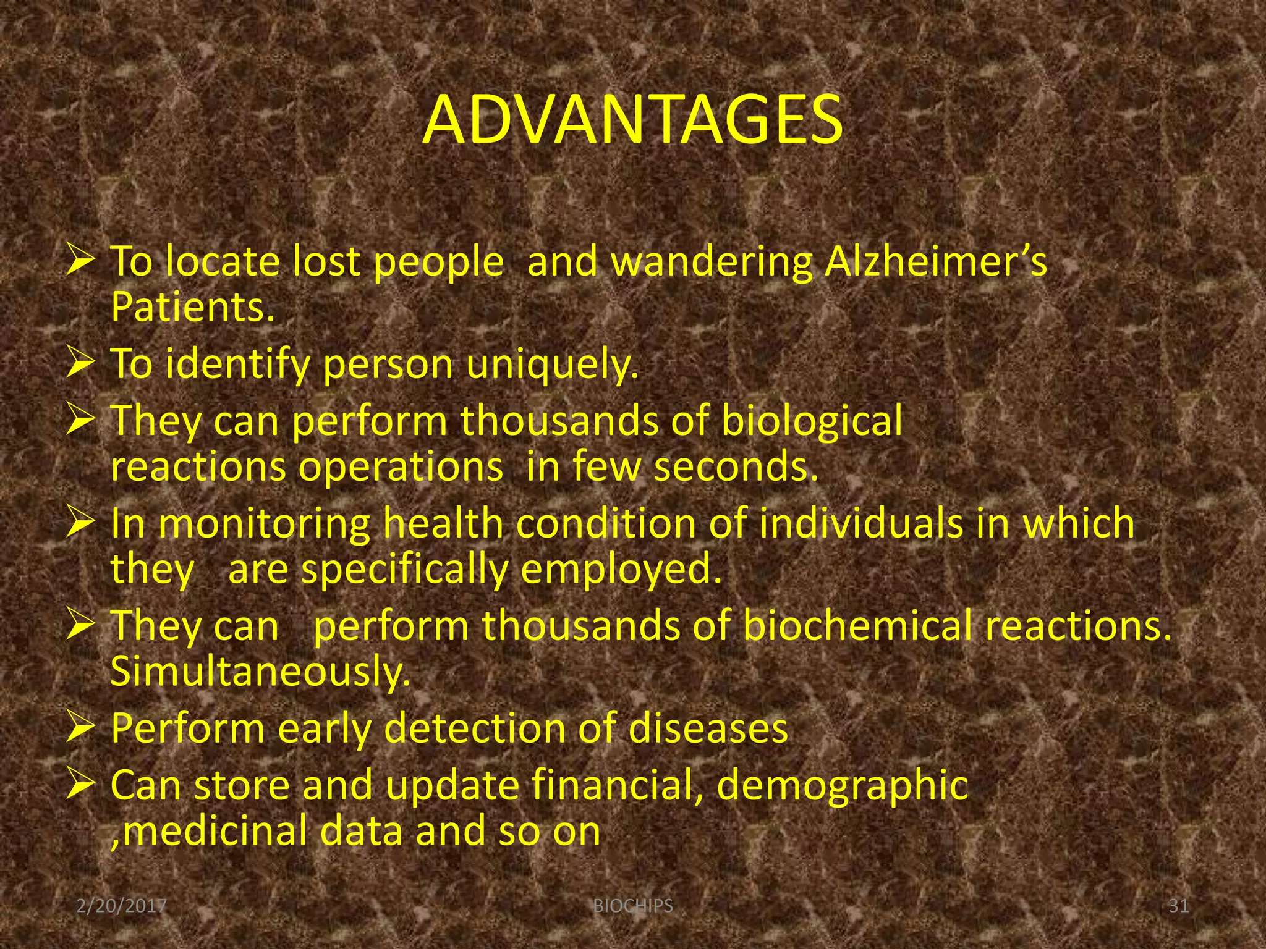

Slide 7
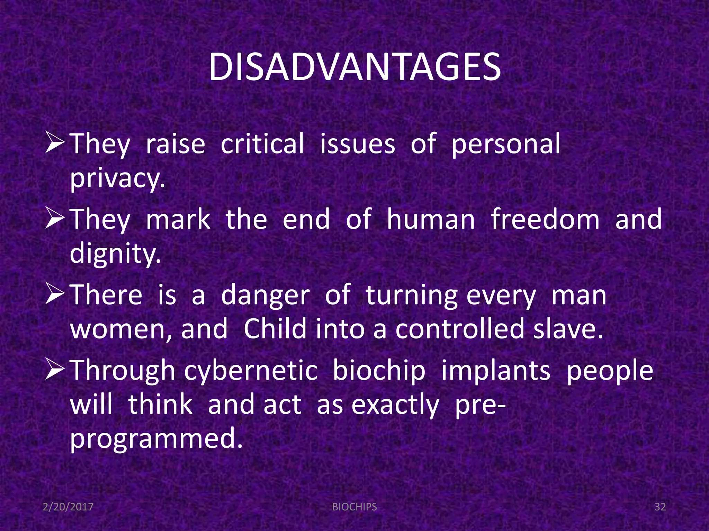

Slide 8
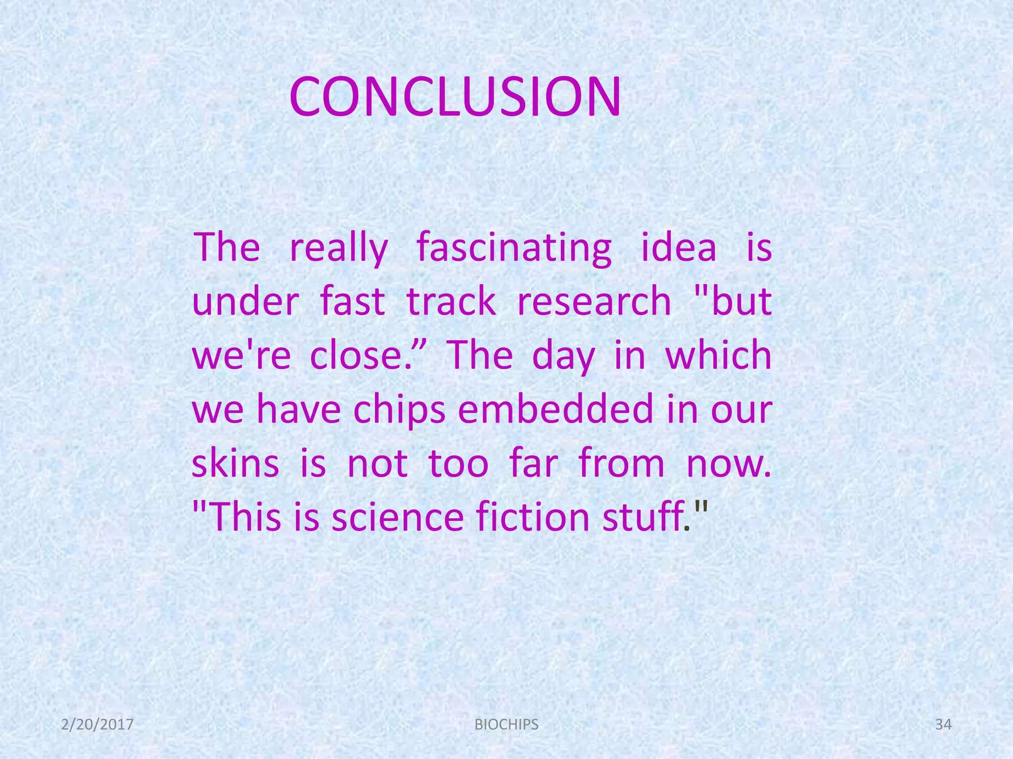

Slide 9


BY :
💜🖤 “ADGK FRNDS”💛❤

